Slide 1

Basics of Effective Communication for beginners
Part -1
Objective: To understand
what is communication and
how to communicate
Part-2 Learn and Practice verbal non verbal and group communication

Slide 2
Basics of Effective Communication
What is communication
What are verbal and non-verbal communication methods
To understand and practice effective listening skills
To communicate in clear, respectful

Slide 3
What is Communication?
The process of communication is what allows us to interact with other people; without it, we would be unable to share knowledge or experiences with anything outside of ourselves.
Common forms of communication are speaking, writing, gestures, touch and broadcasting.

Slide 4
Communication methods
Can we communicate without words?
What is body language ?
What is verbal and non verbal communication?

Slide 5
verbal communication : by speech
Non Verbal communication : By gestures, body language, facial expressions, eye contact and how one dresses
Written communication : by written words using regional and global languages.

Slide 6
What is Business communication ?
Business communications is an umbrella of all the communication types effectively .
What is effective communication ?
Using both specking and hearing and also feeling the message that is communicated .

Slide 7
How Communication reaches us
What you hear
Tone of voice
Vocal clarity
Verbal expressiveness 40% of the message
What you see or feel
Facial expression
Dress and grooming
Posture
Eye contact
Touch
Gesture 50% of the message
WORDS … 10% of the message!

Slide 8
Communication is a 2-way process
sender
receiver
values and attitudes
“generation gap”
sender
language
Cultural differences
noise
hearing
receiver

Slide 9
Effective Communication Skills
Eye contact & visible mouth
Some questions
Body language
Effective
Communication skills
Encouragement
to continue
Silence
Smiling face
Summarising
what has been said
Checking
for understanding

Slide 10
Barriers to Effective Communication
Language
Time
Noise
Other people
Barriers to
effective communication
Distractions
Too many questions
Put downs
Distance
Lack of interest
Discomfort with the topic
Disability

Slide 11
The Art of Listening
“If we were supposed to talk more than listen, we would have been given two mouths and one ear.”
Active Listening
Responding
Paraphrasing
Asking questions for clarification
Mirroring the other person’s language

Slide 12
Group Processes
In groups there are obviously more people, so good communication skills are paramount.
Be mindful to practise:
Observing non verbal cues
Listening, responding, clarifying, paraphrasing and summarising
Identifying barriers to communication
Remember, silence is golden

Slide 13

Break……
Next session on learn and practice Verbal Non verbal communications

Slide 14
Communication skills Part -2
Verbal Non verbal communications

Slide 15
Topics:
What is verbal and Non communication
Tips for verbal and non verbal communication
How to speak, address, convey oral message
How to write a Email, letter ,report by written skills.
How to use verbal and non verbal in group communications.
Demos and Fun activity on verbal & non verbal &group communications..

Slide 16
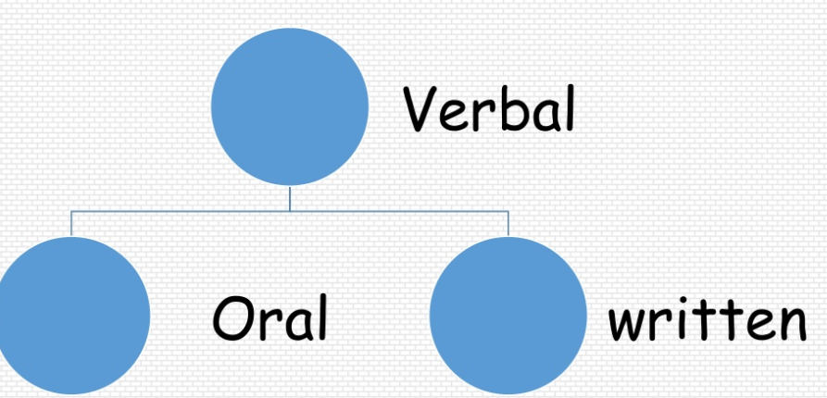
What is verbal communication? Sharing the information by words, speech and using some written information.

Slide 17
Oral communications
It includes
spoken words,
Face to face conversation,
Telephonic conversation,
Video, radio, TV, voice clippings in internet.
Volume of sound, clarity , pitch and speed of words are important for good volar communication.

Slide 18
Written communication
Communication by written information or printed information .
Via Email,
Letter,
Report,
Memo,
Message
Clarity of language and good sense of tense.

Slide 19
Tips for verbal commutation
Start by wishing the person/Group
Example: Hi, Hello, My dear, Respected ,Good morning..
Introduce quickly yourself : Name .. Ex: I am …….
Introduce the Topic /objective
Example: This is Regarding, I am calling to share..
I have message for you about,,
Speak about the topic/message/subject as you planned in simple and clarity.
Cross check the people received your words and meaning..

Slide 20
Tips to written communication
Grammar of the language,
Words (Vocabulary),
Writing style,
Clarity of language

Slide 21
Let us practice ..! Activity of oral communication Fun with Role play game 1) 2 members game sales girl with home products and customer at home.. speak and win .. 2) Tele marketing to tell about summer camp : call over phone and explain about camp. Activity of written communication: 1)send a sample email to camp manager by thanking for the training. 2)Prepare a PPT /Letter/report with topic learned, want to learn, points scored in each ..!!!

Slide 22
Break ….

Slide 23
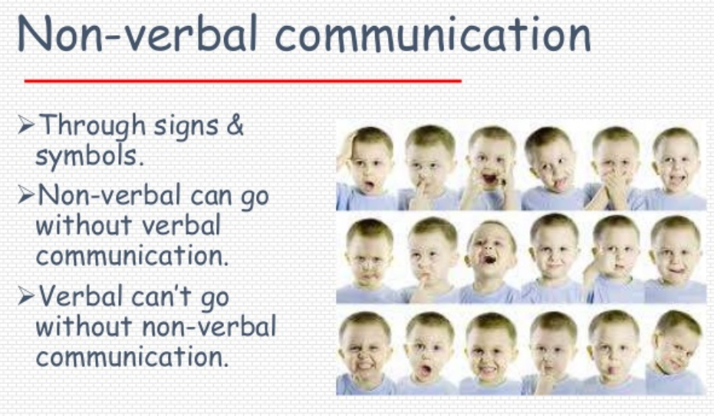
Non verbal communication

Slide 24
Types OF NON VERBAL
Body language,
Face Expressions,
Eye contacts,
Gestures,
Personal appearance,
Proxemics - Personal distance is for interactions

Slide 25
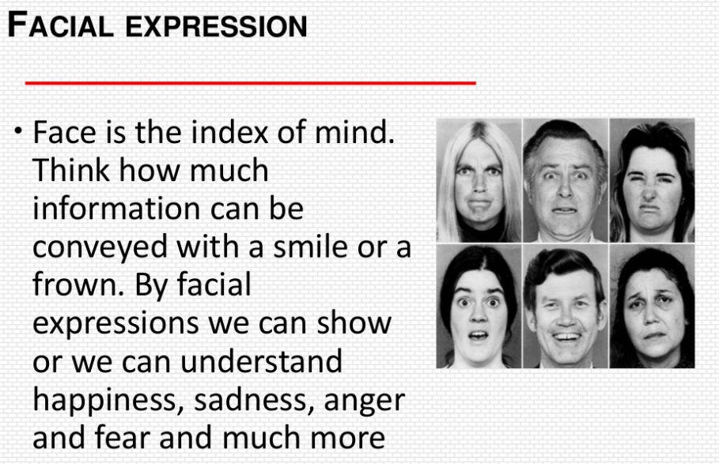

Slide 26
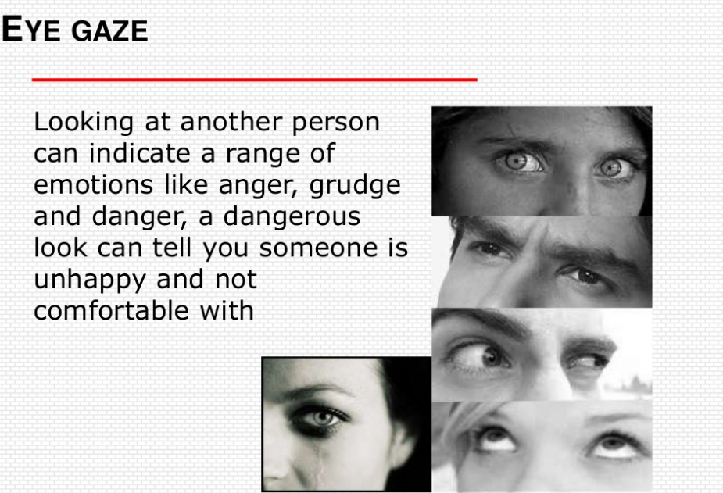

Slide 27


Slide 28
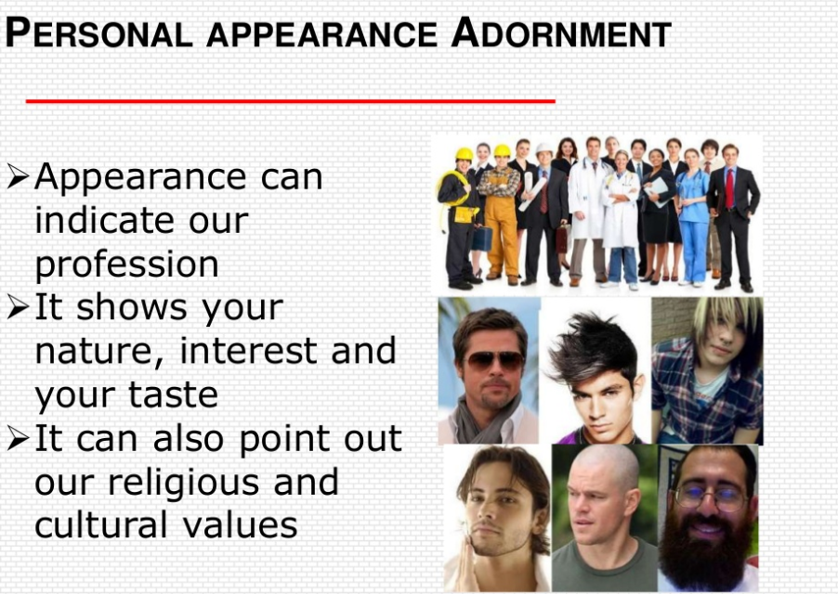

Slide 29

Using all the verbal and non verbal we can succeeded in Group communications

Slide 30
Activity on nonverbal communication
Game (1): Ducks in row game:
Rules: All the participants should observe each other and stand based on high or some similar rules with out talking each others just observe and behave..
Game (2) Charades
Rules: Charades is a classic game, where each player has to act out a word or a phrase without speaking. The rest of the group guesses until they solve the charade.
Game (3): Group discussion:
Rules: follow all the tips learned in verbal an non verbal to discuss given topic

Slide 31
Thank you & Good luck Presentation by CSR team-iNautix Community Services

